Slide 1
BY Pass Attendance

Slide 2
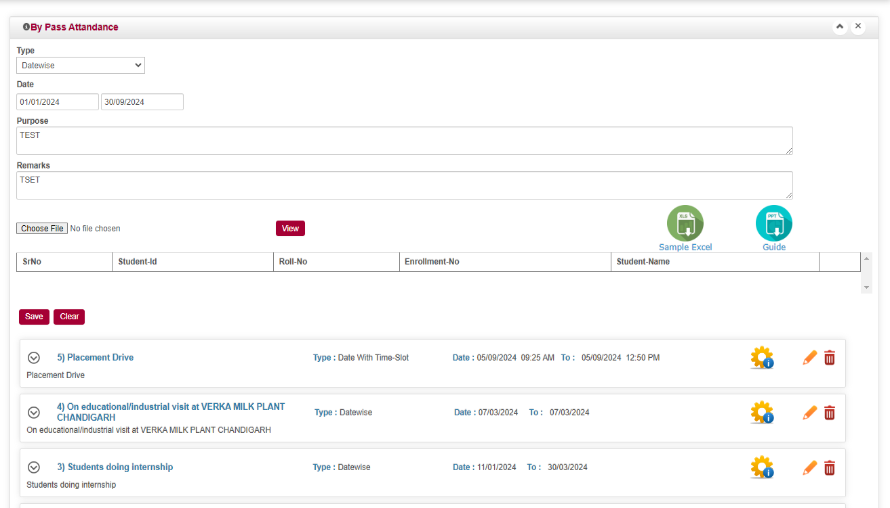
By Pass Attendance
Select Types As per Your Need
Upload Excel and Click on View Button
Enter From Date &To Date
Enter Purpose
& Remarks
Sample Excel Download
Guided PPT For Attendance
Then Finally save Date
Final Click Bypass Attendance Process

Slide 3
By Pass Attendance
Enter Data in Any of One Column For Respective Student Wise Excel Format

