Slide 1

BY Pass Attendance

Slide 2
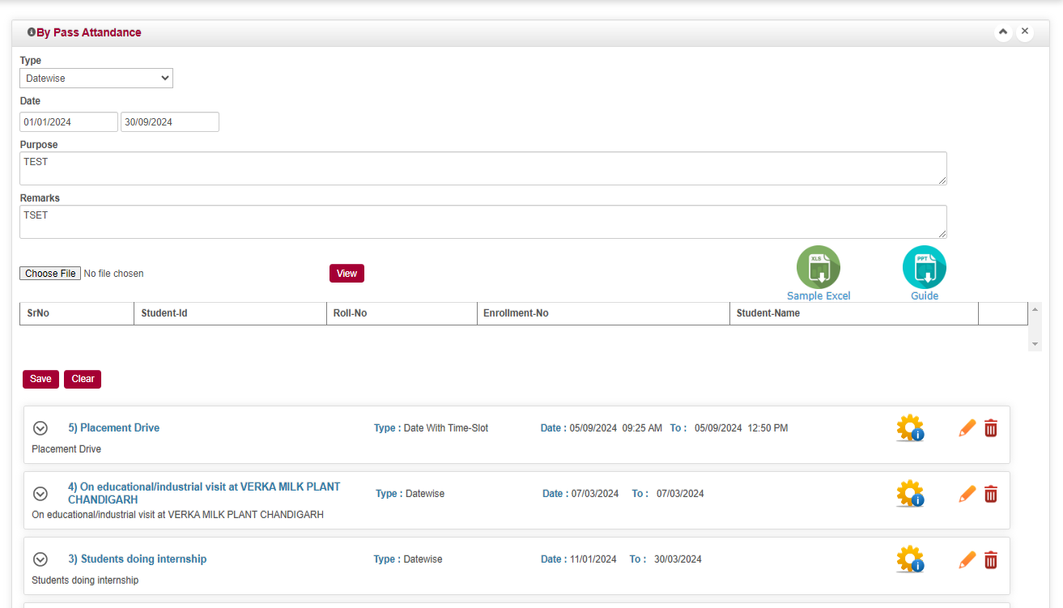
  By Pass Attendance
Select Types As per Your Need
Upload Excel and Click on View Button
Enter From Date &To Date
Enter Purpose
& Remarks
Simple Excel Download
Guide For Attendance
Then Finally save Date

Slide 3
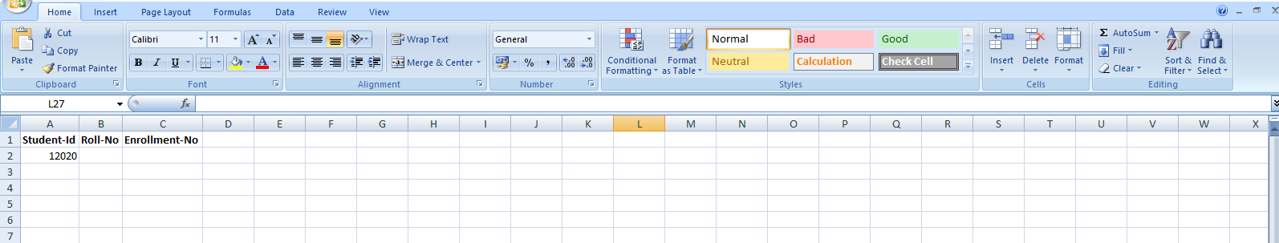
  By Pass Attendance
Enter Data in Any of One Column For Respective Student Wise Excel Format

Slide 4


